Slide 1
Distance not Distant – Supporting and Caring for Independent Distance Learning Trainee Teachers
Dionne Ross
Dr Deborah Bell
Notes:
UK education is punching above its weight, but below its potential
• A plausible estimate is that there are at least 400,000 students studying UK programmes overseas fully or partly through digital means, which represents 60% of the total number of transnational students. Large number and this number is set to significantly increase as the world has acknowledged that this can now be a fruitful and full method of instruction – gone are the days of reading a booklet – waiting for packages to arrive by post – online technologies can do this role much better than previously.
• Why do students want to study a British qualification? There is a whole host of reasons including the reputation of British education and the post colonial effect
• For Teacher education which is mainly focused on postgraduate level we are still ranked above other nations such as Netherlands Germany, Canada and Australia so the International education strategy set out to encourage Uk Universities to take advantage of this and export British education overseas.
• Teacher education is a crucial part of this export as students are looking for course content, good teachers and course organisation employability ,
• example of student in Vietnam

Slide 2
Why is the research important?
Office for students – support students from application to completion
International Ed strategy 2022
Ensuring that current retention figures continue
IITT programme area is continuing to expand
Programme Development
Support after programme completion

Slide 3
Methodology
Mixed methods – Quantitative and Qualitative
6 groups of IITT PGCE Education students
Focus groups to explore the perceptions of students on the role of personal academic tutors from their experiences on the programme
Focus on different areas of support offered
Exploring support mechanisms beyond the programme

Slide 4
Student Support
Good support services is an important characteristic of a successful university (Shattock, 2010)
Effective student support is key in stemming the dropout in distance education (Aluko, 2021)
Support for students is crucial for them to excel in their studies; even more so for those who are studying via distance education institutions because they do not have the on-campus support that students in traditional institutions have (Agboola, 2019)

Slide 5
Support for Distance Learning Students
High rates of attrition in distance-based teacher training courses are in large measure due to feelings of isolation
(Potashnik & Capper, 1998; Hope, 2006).
Indeed, without support, contact and confidence, distance learning is not considered by learners to be valuable
(Brown & Early, 1990; Prescott & Robinson, 1993).

Slide 6
How we do it?
Support Trainees from the beginning to conclusion of the programme
PAT support
Structured development journey which is constantly spiralling knowledge development and applying to practice.

Slide 7
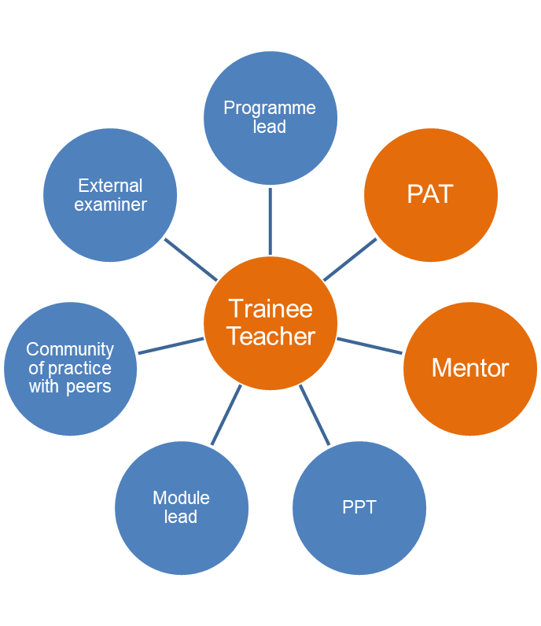
Integrated support
Our VLE (Canvas)
Synchronous and asynchronous online lectures, online discussion forums, creating a community of practice.
Tripartite model of support:
University Personal Academic Tutor (PAT)
In- School Mentor- observes and supports trainee teaching
University Professional Practice Tutors provide additional observations and feedback
Quality Assurance:
An External Examiner QAs samples of assessments and approves all modules and awards

Slide 8
Please rate in order of importance (with the first being the most important and the last being the least important) to your completion of the programme the staff who have worked with you on your PGCE journey
The understanding and support my PAT, mentor and module leaders have offered are what kept me going - completing this program long distance, during COVID circumstances, while having COVID, with a full time teaching job - was a big challenge!
Notes:
We all know the backroom staff don’t get the credit their deserve and it is clear from this data that trainees that those they interact with most are the most important to the trainees
The PAT – adopted across the university now as the term for personal tutors. However our PATS have a larger role to play as they complete all assessments, offer the tutorial sessions and liaise with the school from the beginning of the programme to graduation. This is a continuous source of support.
The co teacher – for those of you unfamiliar with international classroom – quite often there is a native teacher and an international teacher working in the same classroom
The Mentor is with the trainee during their teaching experience and assessments and provides guidance every week on how to further improve practice as well as championing their progress. Part of the support that we as a University try to support with training, access to their own mentor pages in CANVAS but we still need to strengthen our support of mentors.
The face to face support offered are seen as extremely important and reviewing the data on liaison with staff it is clear that the value is associated with frequency and level of support felt.
The AR team follow this in terms of importance and that is before the module leads and the programme lead is seen as least important. The logistical support behind multiple intakes, covid carry overs etc is huge and we have work alongside one another to ensure the students are well supported.
Faculty support. Instructional programs that lead to degrees are organized around substantive and
coherent curricula. A standard practice for instructors that teach online programs is the posting of a detailed
syllabus on the course Web site. Furthermore, the instructor should include a road map for the course, mainly his
or hers expected outcomes (Alonso et al.,2005).
Since, faculty spend tremendous time on course development and maintenance also require a tremendous time
commitment as does course presentation in faculty perspectives (e.g. answering emails, providing feedback, and
securing chat room availability), the administrators of the universities should understand and support faculty.
As academics we know that the writing of the programme and the resources offered by module leads in terms of teaching and support make a programme but when studying from a distance it is so important to make trainees feel they are not distant and it is clear that our PATS fufill this remit effectively being viewed at the same level of importance as the mentors whoa re actually there in the classroom with them.
• The flexibility in programs and assignments offered (e.g. hybrid/alternative case study, dates for starting/completing training placement) due to problems caused by Covid-19 has been invaluable
Module leaders have been great .
Probably having more meeting with PAT and module leaders would be great.
Elizabeth Hidson was an excellent module leader. I really enjoyed that module largely because expectations were so clearly explained. She was also very helpful throughout the course.
Module leaders were very flexible and patient. PAT was very friendly and helpful.
Every member of staff I contacted replied fairly quickly and were helpful in terms of providing information as well as reasonable in giving extensions on deadlines due to personal circumstances.
Perhaps like all good teachers the planning s that goes into programmes such as this should not be visible – just as a great teacher does not allow students to know she worked until midnight to develop a great lesson – the blood sweat and tears are rightly invisible.

Slide 9
Comments
• I would say the PAT played an important role in the completion of this programme. My PAT was all the times available and answering me guiding me all the time. The best thing was the weekly online sessions with the PAT for 1 hour that provided a chance for all to ask questions and take guidance.
My PAT was extremely reassuring during all of our interactions. He was able to redirect my struggles in a way that helped me re-evaluate the situation and use it as a way to grow and develop my teaching practice and my written assignments. Communication was very prompt, professional, and involved a holistic approach in that my mental and emotional wellbeing was always considered.
• "I could not have gotten through the course without the support of my wonderful PAT. Even before I joined the course, they were outstanding in their communication with me, and were always available for weekly catch-ups and one-to-one sessions. They were responsive to emails, and sensitive to the individual issues that each trainee faced. In addition to the practical feedback on assignments, the PAT went above and beyond to lend an ear and to share advice. They really understood each student, and kept moral high in our weekly group meetings, as various trainees faced unique ups and downs throughout the year.
My PAT was absolutely amazing throughout this course. Always supportive and approachable.
Notes:
Throughout the programme I would like to say that my PAT was very accommodating and supportive, especially during COVID-19. She was very accommodating when it came to scheduling weekly meetings around everyone in her cohort. During these meetings she was able to answer all of the trainees' questions and support them when they had concerns as well as clarify things when the information wasn't always available. She was very reassuring and answered any question I had over email. Her feedback on assignments has always been very insightful and allowed me to further reflect on my studies and professional development as a teacher. I would not have been able to do this without her

Slide 10
Tutorials with PAT

Slide 11
Characteristics of PAT

Slide 12
Relationships

Slide 13
Integrating Research and Practice
Two research modules on programme:
Case Study
Action Research

Slide 14
Supporting Students with Integration of Research
Mention Sunrae?

Slide 15
Constructing your title.mov
Action research – the one that brings everything together.
SUNRAE – examples of work undertaken
https://ojs.sunderland.ac.uk/index.php/sunrae.
The podcast is available through anchorFM https://anchor.fm/sunrae/

Slide 16
References
Agboola, Caroline. Proceedings of the European Conference on e-Learning. 2019, p651-654.
Aluko, F.R. (2021) Evaluating student support provision in a hybrid teacher education programme using Tait’s framework of practice. Open Praxis, vol. 13 issue 1, January–March 2021, pp. 21–35
Hope, A. (2006). Factors for success in dual mode institutions, Vancouver, Commonwealth of Learning.
Hord, S., Rutherford, W.L., Huling-Austin, L. & Hall, G.E. (1987). Taking charge of change. (Austin, TX, Southwest Educational Development
Potashnik, M., & Capper, J. (1998). Distance education: Growth and diversity. Retrieved, July 22, 2009 from: http://www.worldbank.org/fandd/english/0398/articles/0110398.htm.
Prescott, W. & Robinson, B. (1993). Teacher education at the Open University, in H. Perraton (Ed) Distance Education for Teacher Training, London, Routledge Press, 287- 315.
Shattock, M. (2010) Managing Successful Universities. 2nd edition. McGraw Hill: Open University Press.

